Slide 1

Best Lecture – website for student
About the project
The student’s of Warsaw School of Economics have to choose the subjects, lecturers and arranges the schedule of classes (based on the study guide and the information contained therein). This is called semester declaration and it has to be completed within strictly defined deadlines. It is very important to complete all necessary courses for a given field of study. The problem to work through is the difficulty that students find in choosing the right lecturer and interesting courses. The assumption of project is to create a tool that facilitates finding a classes and teacher, appropriate for the student.

Slide 2


Design process
01_UX strategy
02_UX design
03_Prototype and tests

Slide 3
UX Strategy
UX Design
UX Prototype and tests
User analysis
Purpose
Target group
Student surveys
Make it easier for student to choose the right lecturers and courses.
Student of all faculties and types of studies at Warsaw School of Economics.
Surveys conducted using a Google Form.
SURVEY

Slide 4
UX Strategy
UX Design
UX Prototype and tests
Surveys results
Do you look for information about the subject and the teacher before signing up for classes?
Answered: 32

Slide 5
UX Strategy
UX Design
UX Prototype and tests
What are your main guidelines when choosing a teacher and a course? (multiple choice) Answered: 32

Slide 6
UX Strategy
UX Design
UX Prototype and tests
What information are you looking for before signing up for course? (multiple choice) Answered: 32

Slide 7
UX Strategy
UX Design
UX Prototype and tests
Is it difficult for you to find this information? Answered: 32

Slide 8
UX Strategy
UX Design
UX Prototype and tests
What are the problems you faced when you trying to find information about a
course / lecturer? Answered: 32

Slide 9
UX Strategy
UX Design
UX Prototype and tests
Conclusions from surveys
Most students look for information about the course and teacher before choosing it.
Over 40% of respondents have problems finding interesting information.
Students are mainly influenced by the opinion of others. They look for information on Facebook and in the study guide.
The most important for students is:
a) way of conducting classes
b) rules for completing the course
c) lecturer’s behawior
d) practical use of the course

Slide 10
UX Strategy
UX Design
UX Prototype and tests
Business analysis
When building the UX trategy, I conducted a SWOT analysis, defined the goal using the S.M.A.R.T model and tried to propose solutions through Value Proposition Canvas.
Then I moved to Business Model Canvas, which in my opinion is a very useful tool in creating UX strategies. It combines the conclusions of all the methods used.

Slide 11
UX Strategy
UX Design
UX Prototype and tests
Business Model Canvas
Key activities
Key partners
Value proposition
Customer relationship
Customer segments
Users: obtaining information about lecturers and subjects, possibility of expressing opinions
Students, graduates, lecturers, university office.
Access to onformation about courses and lecturers
Knowledge gathered in one place
Indirect help in choosing a career path
Co-creating helpful content, creating an academic community
Students of all faculties and graduates
Business: keeping the website working well, responding to user problems
Key resources
Channels
Students comments and opinions
Social media – Facebook, website of the universiy
Cost structure
Revenue streams
Cost of maintaining the website architecture, cost of securing databases, marketing
Advertising, student suport (donated).

Slide 12
UX Strategy
UX Design
UX Prototype and tests
Competitors analysis
The competition is mainly the website of the University itself, which provides information about the courses (study guide) and information about the lecturers. Besides, students only use Facebook groups as a source of information. There is currently no other place and tool that collects and shares infromation that can help students better choose courses and teachers.
The American website – Koofers – may be an inspiration. The website offers the possibility to evaluate the course and lecturers as well as study materials and job offers.
Analysis of the most important functions of Koofers.com

Slide 13
UX Strategy
UX Design
UX Prototype and tests
User persona
Information architecture
User stories
User journey
User flow
Define everything about user.

Slide 14

UX Strategy
UX Design
UX Prototype and tests
Daria Szwankowska, 21 years, Student of economics, 2nd year, bachelor’s degree
Daria studies daily and rents a room in Warsaw, she’s focused on studying and college life. She wants to find a good job in the some company’s finance in the future. She is ambitious and likes to learn.
Goals
Graduate studies
Get good grades
Learn a lot
Get a good internship
Frustrations
Not getting enough knowledge
She learns only theoretical things
She won’t find a good job
She doesn’s know how to direct her development
Presonality
Ambitious, cheerful, she likes to meet new people and easily makes new friends, often takes the initiative, extrovert

Slide 15

UX Strategy
UX Design
UX Prototype and tests
Michał Więckowski, 25 years, Student of big data,
1st year, masters degree
Michał works as a developer and earns well, he treats studies as a formality. He just wants to have a complete education but he focused on his professional work. He has little free time, he wants to finish his studies quickly.
Goals
Focus on work
Have no problems at the university
Graduate quickly form university
Frustrations
He doesn’t have time to study
He is afraid of failing his classes
He is afraid that he won’t be able to work and study at the same time
Presonality
Disciplined, independent, introvert, he prefers to sorround himself with trusted people

Slide 16
UX Strategy
UX Design
UX Prototype and tests
Information architecture
HOME PAGE
Lecurers profile
Course
Lecturers
Students opinions
Subject description
Courses
Courses
Students opinions
Declaration schedule
General description
Way of conducting classes
required
passed
saved
Pass a subject
My courses
Presence
Other
homeworks
Account settings
Study quide

Slide 17
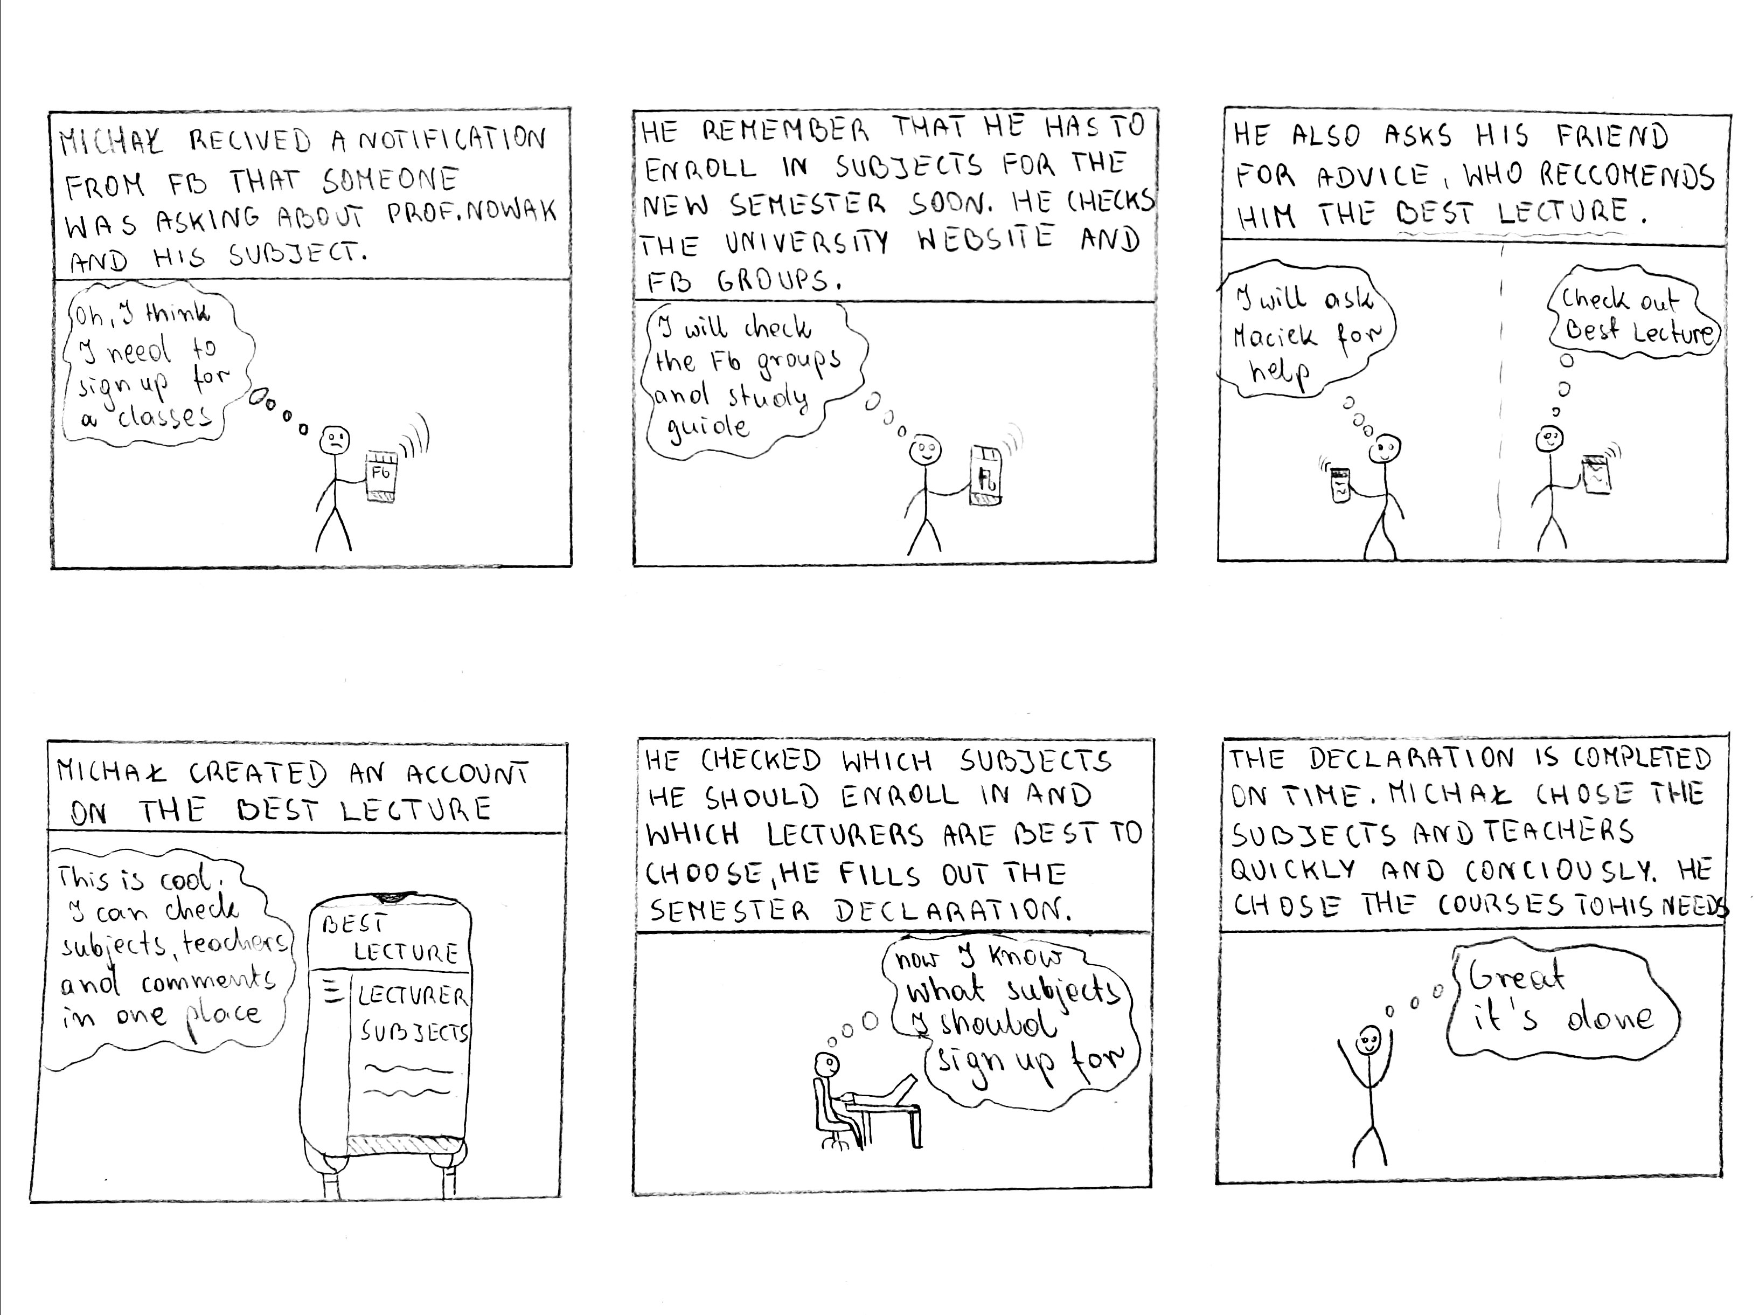
UX Strategy
UX Design
UX Prototype and tests
User stories

Slide 18
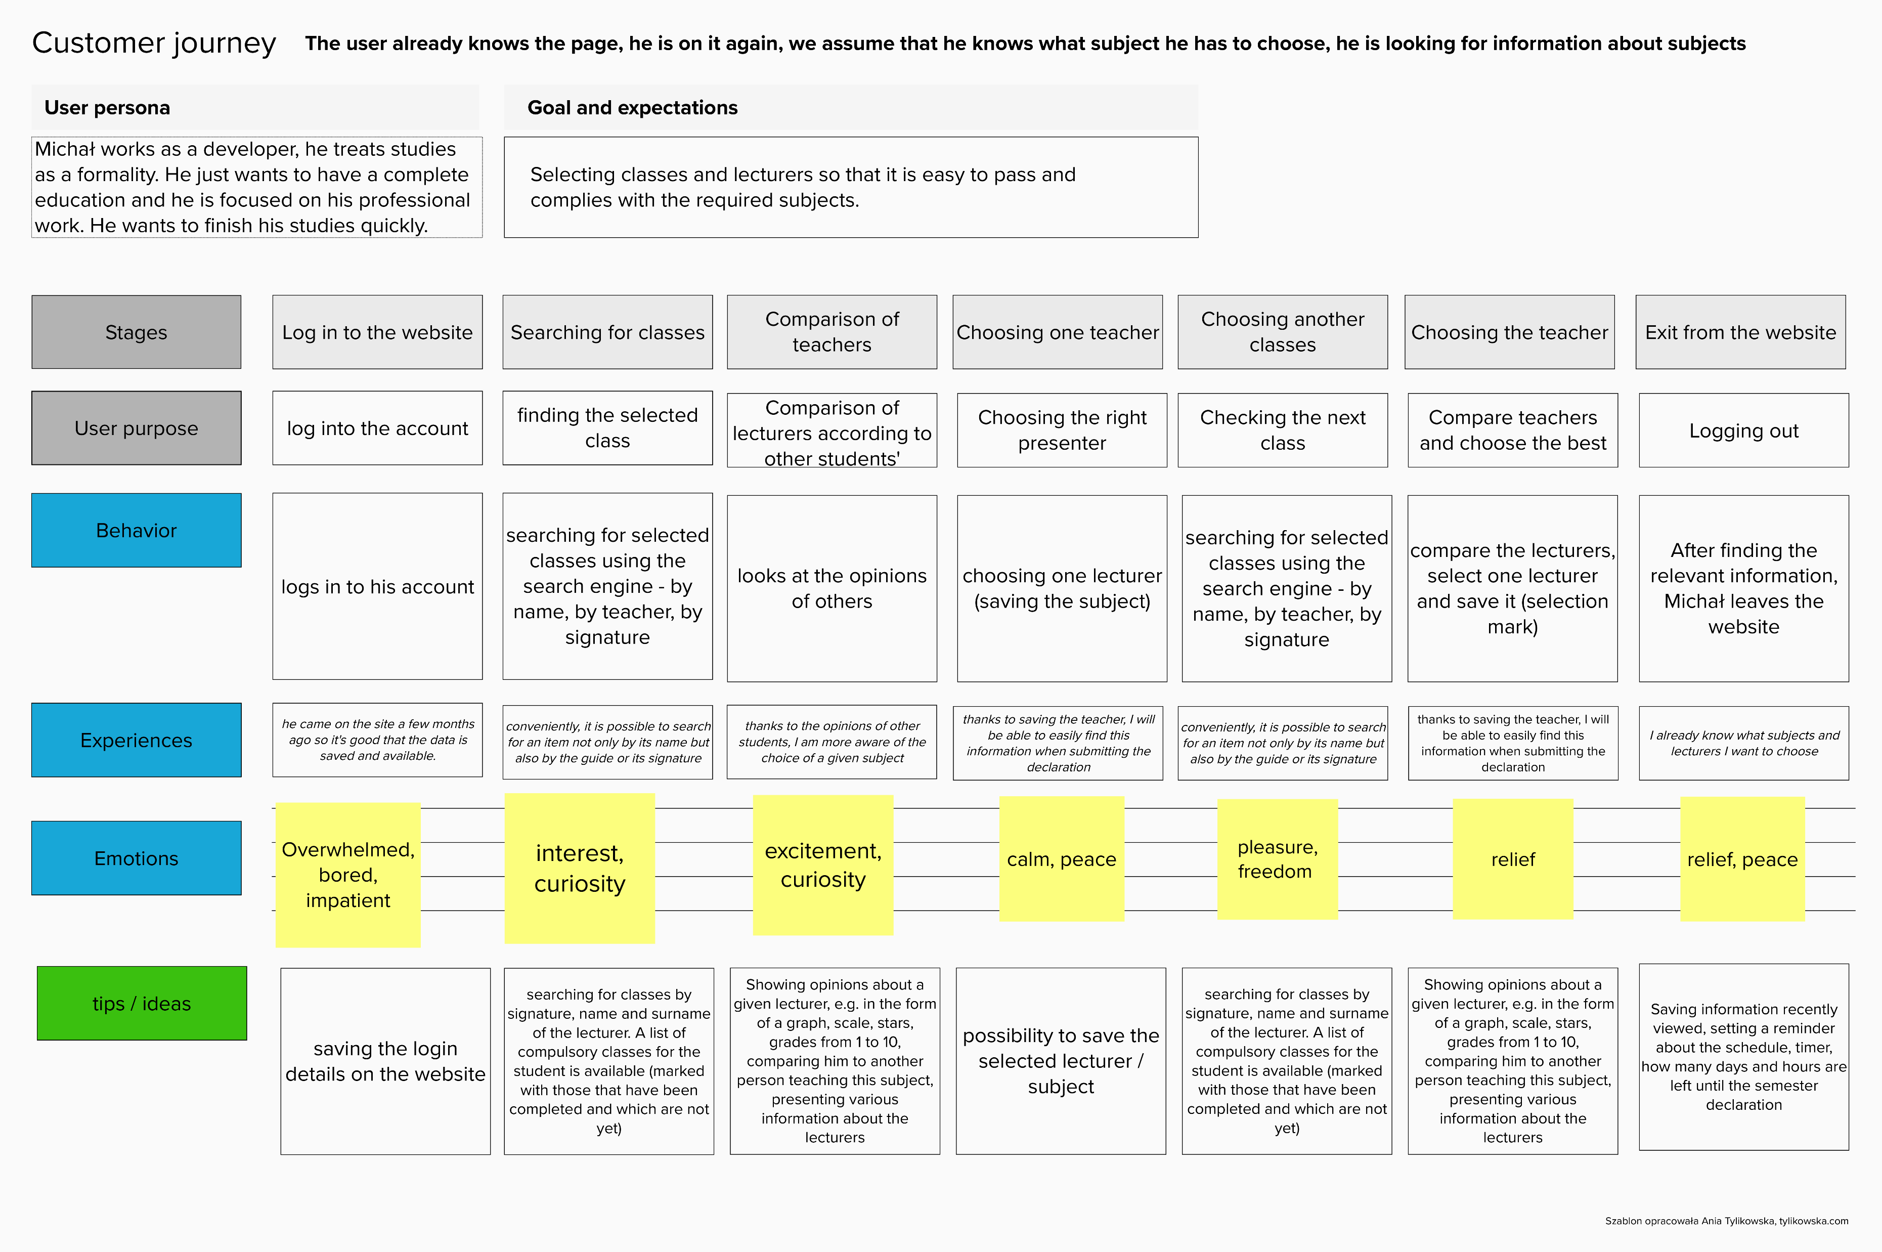
UX Strategy
UX Design
UX Prototype and tests
User journey

Slide 19
UX Strategy
UX Design
UX Prototype and tests
User journey
It is important to keep login details, because the demand for using the website will be rather seasonal – furing the period of submitting the semester declaration.
There are many subjects and lecturers and it may be difficult for the user to remember them. A list of compulsory subjects and the ability to save it may be helpful.
The most important for the user are the opinions of other students, so the path to tchem should be as short as possible.
User may want to search for lecturer or subjects by different keywords, e.g. subject reference numer, surname, course name

Slide 20
UX Strategy
UX Design
UX Prototype and tests
User flow
comments
User
Study guide
User activity
Open website
Change/reset password
Account settings
Other
Hide/show
Have an
account?
Yes
Log in
Home screen
clock
Exit/sign out
No
Sign up
Search engine
(signature, name of the course, teacher’s name)
Users courses
Lecturers
Courses
Decalration schedule
Name, surname, e-mail adress, year of study, field of study, degree, mode of studies, adding courses (optional)
List of courses (required, passed, saved)
List of lecturers, search engine
List of courses, search engine
Lecturer profile
Course screen
Confirmation e-mail
Saving the course, marking as passed, adding/removing/editing comments

Slide 21
UX Strategy
UX Design
UX Prototype and tests
Prototype
Based on the tool an methods described above, I created a website prototype.
On the following slides I have described a few functionalities and below I have included the user path for the lecturer search function.
Mobile prototype

Slide 22

UX Strategy
UX Design
UX Prototype and tests
Home page
It is important to define what a page is and what can be done on it.
A clear call to action for registration because that’s what we want froum our user.
The three most important functions of our website:
Searching for a lecturer
Searching for a course
Declaration schedule date

Slide 23
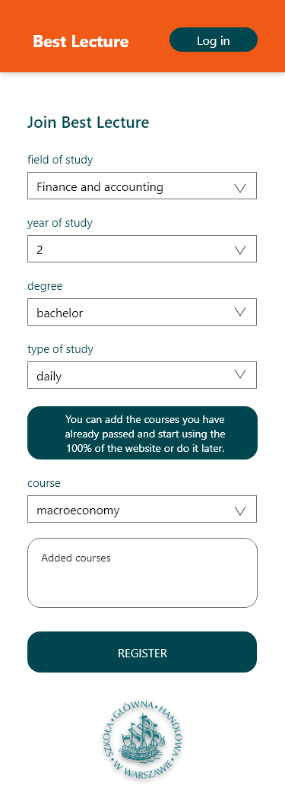
UX Strategy
UX Design
UX Prototype and tests
Registration form
After ompleting the basic data (password, e-mail addres), the user is asked to provide basic information about his studies.
Although the reistration may take a bit longer, the user wil be able to use 100% of the website’s functions immediately after logging in. The student will see e.g. deadline for submitting the semester declaration and the compulsory classes for his field of study.
The user can also complete courses already passed, but this is optional funkction.

Slide 24
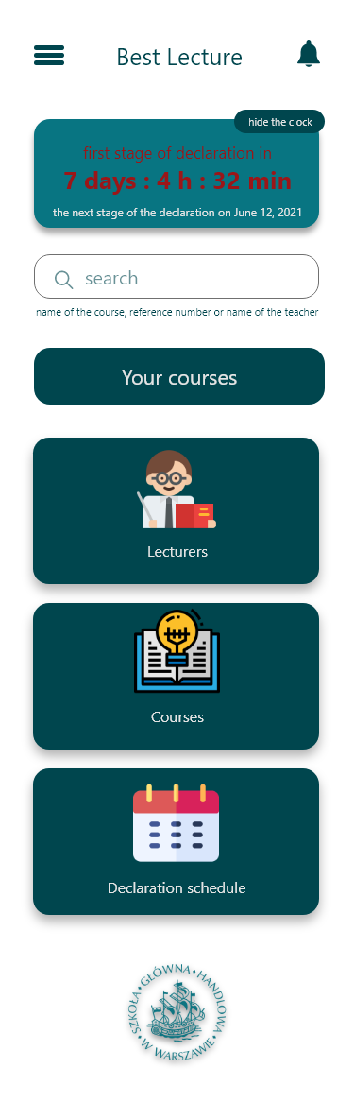
UX Strategy
UX Design
UX Prototype and tests
Home page (after logging in)
A clock specyfying how much time is left until the end of term declaration.
A search engine under which there is a hint on what to enter (the name of the course, reference numer or name of the teacher).
’ Your courses’ – the tab containing a list of passed, saved and compulsory courses.
The three previously mentioned functionalities: access to the list of lecturers and courses and the declaration schedule.

Slide 25
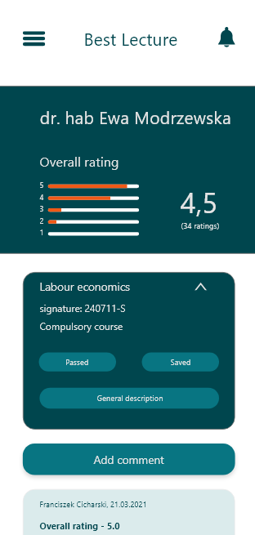
UX Strategy
UX Design
UX Prototype and tests
Lecturer profile (1)
There is name of the lecturer and his overall rating of students what is shown with a graph.
Below, user can see signature of the course and information that this is his compulsory course. There is also general description of the course and possibility to save the course or mark it as passed.

Slide 26

UX Strategy
UX Design
UX Prototype and tests
Lecturer profile (2)
When adding comments, students have to fill in several fields, which will help to organize the information (categories to be filled in are determined on the basis of surveys).
Typically, lecturers teach more than one course. Therefore, students rate the lecturer but in the category of the course in which they had classes.
At the end, a very short description of the lecturer.

Slide 27
UX Strategy
UX Design
UX Prototype and tests
Functional tests
I conducted tests among several potential users. Users were asked to search for a teacher and course, and add comments. Potential users who participated in the tests didn’t have major problems with completing the tasks. However, at a few moments there was no clear descripton or helpful functions. Below are some conclusions about it.
The text on the main page should be corrected so that users know exactly what the Best Lecture website is about.
The respondents wanted to be able to filter the comments in terms of the overall rating of the teacher and the date of comment.
Immediately after saving the course, we should give the user the option to undo this action (in case of accidental action).
It is worth remembering that some students have more than one field of study. Then they have more compulsory courses and different deadlines for the semester declaration.

Slide 28
What have I learned during this project ?
Even if we think that we know the target group, it is worth relying on persons or our surveys, because it is easy to lose some features and functionalities that our project should have.
It happened that what I worked on for the longest time had the least importance for the user, so it is worth returning to tools such as Value Proposition Canvas or Business Model Canvas.

